Slide 1
CSE 226: Digital Logic Design Lab Sequence recognizers United International University

Slide 2

Objective
Implementing Sequence Recognizer using
J-K Flip flops
D Flip flops
Our example will detect the bit pattern 1001, while overlap will be supported

Slide 3
State Diagram
0
00
1
01
1
0
1
1
0
11
10
0

Slide 4
State table
Present state |  | Input | Next state |  | Output | J1 | K1 | J0 | K0
Q1 | Q0 | x | Q1 | Q0 | z
0 | 0 | 0 | 0 | 0 | 0 | 0 | X | 0 | X
0 | 0 | 1 | 0 | 1 | 0 | 0 | X | 1 | X
0 | 1 | 0 | 1 | 0 | 0 | 1 | X | X | 1
0 | 1 | 1 | 0 | 1 | 0 | 0 | X | X | 0
1 | 0 | 0 | 1 | 1 | 0 | X | 0 | 1 | X
1 | 0 | 1 | 0 | 1 | 0 | X | 1 | 1 | X
1 | 1 | 0 | 0 | 0 | 0 | X | 1 | X | 1
1 | 1 | 1 | 0 | 1 | 1 | X | 1 | X | 0

Slide 5
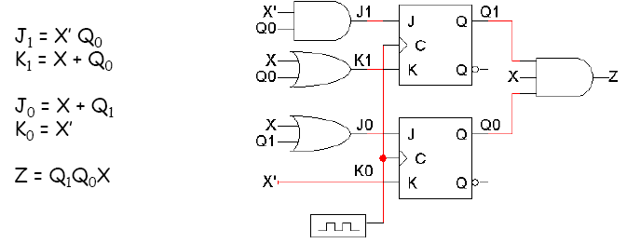
Implementing with J-K
Equations and logic diagram

Slide 6
Implementing Logisim
First, implement the circuit diagram in Logisim.

Slide 7
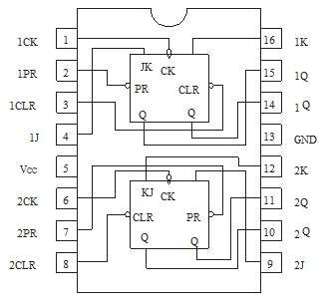
7476: Dual J-K Flip-Flops (with Preset and Clear)

Slide 8
Timing diagram
Here is one example timing diagram for our sequence detector.
The flip-flops Q₁Q₀ start in the initial state, 00.
On the first three positive clock edges, X is 1, 0, and 0. These inputs cause Q₁Q₀ to change, so after the third edge Q₁Q₀ = 11.
Then when X=1, Z becomes 1 also, meaning that 1001 was found.
The output Z does not have to change at positive clock edges. Instead, it may change whenever X changes, since Z = Q₁Q₀X.
1 2 3 4
CLK
Q₁
Q₀
X
Z

Slide 9
Writing Report
State diagram
Flip-flop assignment table
K-maps
Circuit diagram
Pin diagram of flip-flop IC

